Slide 1
Provided by
Suzelle Guinart, LMHC - Director
Let us help you maximize your best self!

Slide 2
A place to explore your thoughts and feelings in order to build skills to handle life's trials and accomplish your goals.
Notes:
Henderson student counseling services provides the opportunity for students to benefit from working on personal issues
A behavioral health professional can suggest ways to cope and better understand
The counseling center is staffed by experienced, licensed behavioral health professionals including a psychiatrist if you are in need medication management

Slide 3
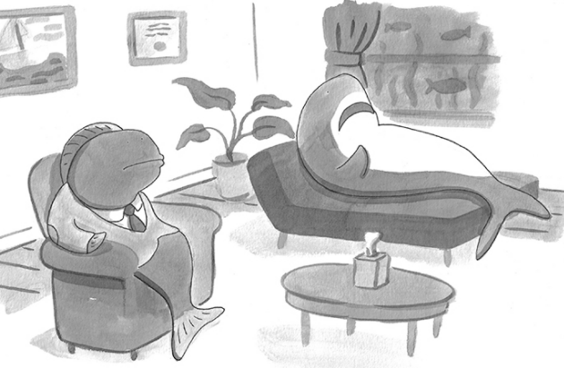
We can help with:
Relationship Challenges
Couples Counseling
Social Anxiety
Stress Management
Test Anxiety
Depression
Panic and Anxiety
Problem Solving & Goal Setting
Substance Abuse
Eating Disorders and Body image
Grief And loss
Adjustment to Student Life
And much more….
Notes:
Counseling is not just giving advice for a quick fix
Seeing a counselor, you will have opportunities to:
Talk in a safe, non-judgmental environment
Talk about anything that might be causing you distress
Learn that you are not alone in this
Find your path for self-growth

Slide 4
Screening Session
+10 Free Counseling Sessions
Individual / Couples/Family Counseling
Psychiatric Services Available
24/7, 7 days a week Crisis Hotline
Confidential
Non-diagnostic
In-person / Telehealth (video)
Call (954) 424-6911
(on-campus dialing (2-7050)
OR
Log into portal to set up 1st appt.
https://www.hendersonbh.org/t-student-counseling-services/nova/
Notes:
Students are provided the opportunity to express their emotions in an uninhibited and safe environment
The counseling relationship is objective, non-judgmental, and understanding
The counseling relationship is confidential
Services are provided by licensed clinicians

Slide 5
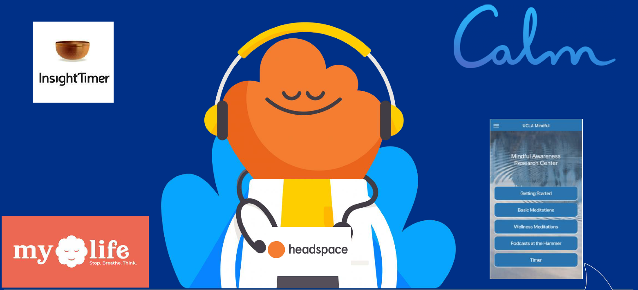

Slide 8
Hours of Operation:
Monday 8:30am – 6:00pm
Tuesday 8:30am – 8:00pm
Wednesday 8:30am – 8:00pm
Thursday 8:30am – 6:00pm
Friday 8:30am – 5:00pm
On-Call Crisis Counselor available
24hrs/7days wk /365 per year
Services provided in person or via Telehealth

Slide 9
Davie Main Campus:
Student Affairs Building 3rd Floor
In Person &
Telehealth Services
Available
https://www.hendersonbh.org/t-student-counseling-services/nova/

Slide 10
Phone Numbers
Office:
954-424-6911 or 954-262-7050
Crisis Hotline:
954-424-6911 or 954-262-7050
(available 24 hours, 7 days a week)
https://www.hendersonbh.org/t-student-counseling-services/nova/

