Slide 1
Public Safety

Slide 2
NSU PUBLIC SAFETY DEPARTMENT
Our Public Safety Department has 116 employees
75 are Uniformed Patrol and building Officers
We do proactive patrolling 24 hours a day and have a 24 hour a day dispatch Security Operations Center
We have over 2,000 cameras on our campuses. Approximately 1200 are on the main campus.
We also have 100 Blue Light Phones around the campus.
We have 5 Davie Police Officers assigned full time to our main campus. One of these Police Officers is assigned to University School.
Dispatch number: (954) 262 - 8999

Slide 3
WEAPONS ON CAMPUS
There are no weapons permitted on campus.
A Concealed Weapons Permit does not allow you to carry a firearm on any school grounds in Florida
NSU rules apply to ANY kind of weapons, including tasers, throwing stars, or any other item that is used as a weapon.

Slide 4
OTHER SERVICES
We can help you if you need any of the following services:
Battery jump starts
Key lockouts
Tire filling
Escort Services

Slide 5
LOST AND FOUND
We have a Lost and Found inventory at the Campus Services building on SW 36th Street.
Call the Service Desk at 954-262-8985 to see if your property has been turned in.
Please turn in all found or lost property as soon as possible. The one who lost the property may be looking for it the same day.

Slide 6
PARKING RULES & ENFORCEMENT
Parking rules are enforced and tickets are written
Park only in designated spaces in lots as assigned or permitted.
Nova.edu/parking

Slide 7
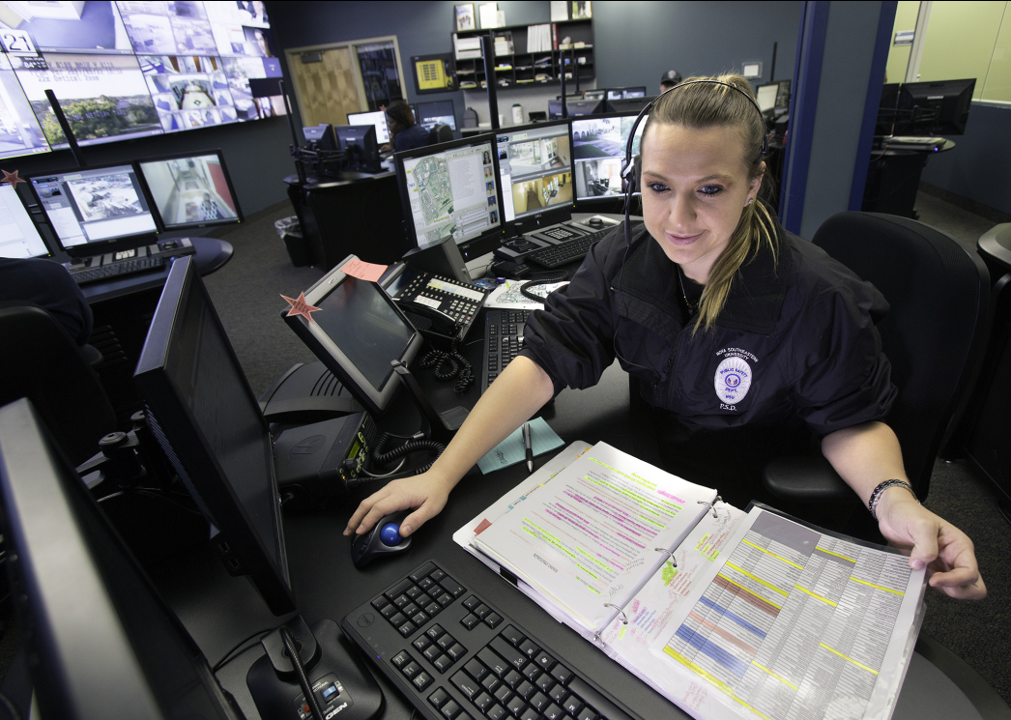
PSD SECURITY OPERATIONS CENTER
24 hour radio dispatching
Centralized security access control system and constant alarm monitoring
Digital video monitoring and recording of 2000 surveillance cameras
Centralized telephone communication including more than 100 emergency blue light telephones

Slide 8
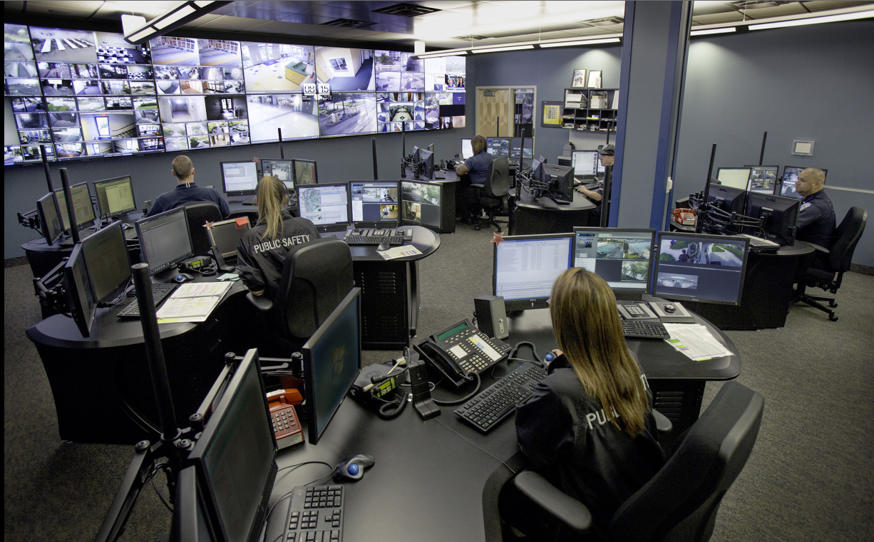

Slide 9
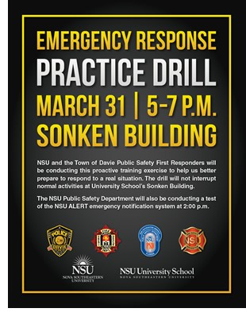
NSU Safety Alert System nova.edu/emergency

Slide 10
Personal Safety
Always be aware of your environment and the people around you
Take note of the two nearest exits in any building you are in
Have a personal plan
If you see something out of the ordinary or suspicious, call the police or public safety

Slide 11
Fire Safety​
It is mandatory to evacuate when the fire alarm sounds.​
Candles, incense, and open flames are not permitted on campus.​
Smoking and tobacco use is not permitted on campus.​
Space heaters are not permitted on campus.​
Always insure that you are aware of two ways out wherever you are.​
Familiarize yourself with the evacuation maps in your buildings.​
If there is a fire, pull the fire alarm, evacuate, and call 911.​
If you have any safety concerns, please report them to Dispatch.​

