Slide 2
Title IX and NSU:
A Brief Introduction
College of Psychology
August 2022

Slide 3
Overview of Title IX Office
2.5 Staff (Title IX Coordinator, Deputy Coordinator/Investigator, & Graduate Assistant)
Ensure institutional compliance with Title IX
Provide immediate and on-going support to victims of sexual violence and sexual harassment
Investigate and resolve formal complaints of sexual harassment under Title IX
Coordinate prevention and on-going awareness programs designed to reduce the risk of sexual harassment.
Provide verification for pregnant students to be able to receive appropriate academic accommodations under Title IX
Notes:
Title IX provides resources across disciplines

Slide 4
Title IX: Your Rights and Responsibilities as a Student

Slide 5
NSU Prohibits
Sexual assault/rape
Non-consensual sexual contact
Dating and domestic violence
Stalking
Sexual harassment, including “quid-pro-quo”
Sex-discrimination
Sexual exploitation
Gender-based harassment
Hostile environment based on sex or gender
Discrimination based on pregnancy/parenting status
Retaliation
Notes:
NSU’s anti-discrimination statement also protects gender identity and expression

Slide 6
Examples of Support from Title IX Staff
Review of options for assistance on- and off-campus
Absences excused for forensic exam, reporting to police, medical care, or other immediate consequences.
Accommodations for pregnant or parenting students
Assistance reporting to law enforcement
Follow-up with court proceedings, investigators or others
Safety planning, especially in abusive or stalking situations
Referrals for counseling, DV shelters, temporary housing, or legal aid
Coordination of civil orders of protection or no contact orders

Slide 7
Examples of Supports & Resources
Connecting a student to counseling on- or off-campus
Helping a student learn where to get a SANE exam
Getting a student access to emergency housing
Assistance reporting to law enforcement
Assistance obtaining legal aid or a civil order of protection
Verification of absences related to incident
Changes of schedule, room, or classes
Imposition of campus no-contact orders
Information about formal complaint/investigation process
Notes:
Mainly about giving information, resources, and options

Slide 8
What YOU can do!
Read the Policy • Report Incidents
Respond with Care • Reduce Risk
Notes:
As a new member of the NSU community, you play an important role in helping to prevent or minimize the effects of sexual misconduct at NSU.

Slide 9
Report Concerning Behavior
Directly to the Title IX Coordinator
Preferred: Via secure online reporting form at nova.edu/title-ix.
By phone: 954-262-7858
Via e-mail: laura.bennett@nova.edu
To University faculty or staff
All university employees are required to report sexual misconduct to the Title IX Coordinator
Laura Bennett,
Title IX Coordinator
***Crimes and/or immediate threats should be reported to 9-1-1, local law enforcement, or NSU Public Safety (954-262-8999) ***
Notes:
Next, it is important to recognize and report inappropriate conduct and behavior to the appropriate authorities.
If you experience, observe, or otherwise become aware of sex-based misconduct affecting a member of our community, you have the RIGHT to report it to the NSU Title IX Coordinator.
You can share your experience with the Title IX Coordinator via a secure online reporting form, by phone, or email.
You may also choose to disclose your experience to a trusted faculty member, administrator, or staff member. Just know that with very few exceptions, all NSU employees are required to report sexual misconduct to the Title IX Coordinator to ensure that those affected are appropriately supported and connected to resources. This includes faculty, advisors, Resident Assistants, and coaches.
If what happened may also be a crime, you can also report your experience to local law enforcement directly.

Slide 10
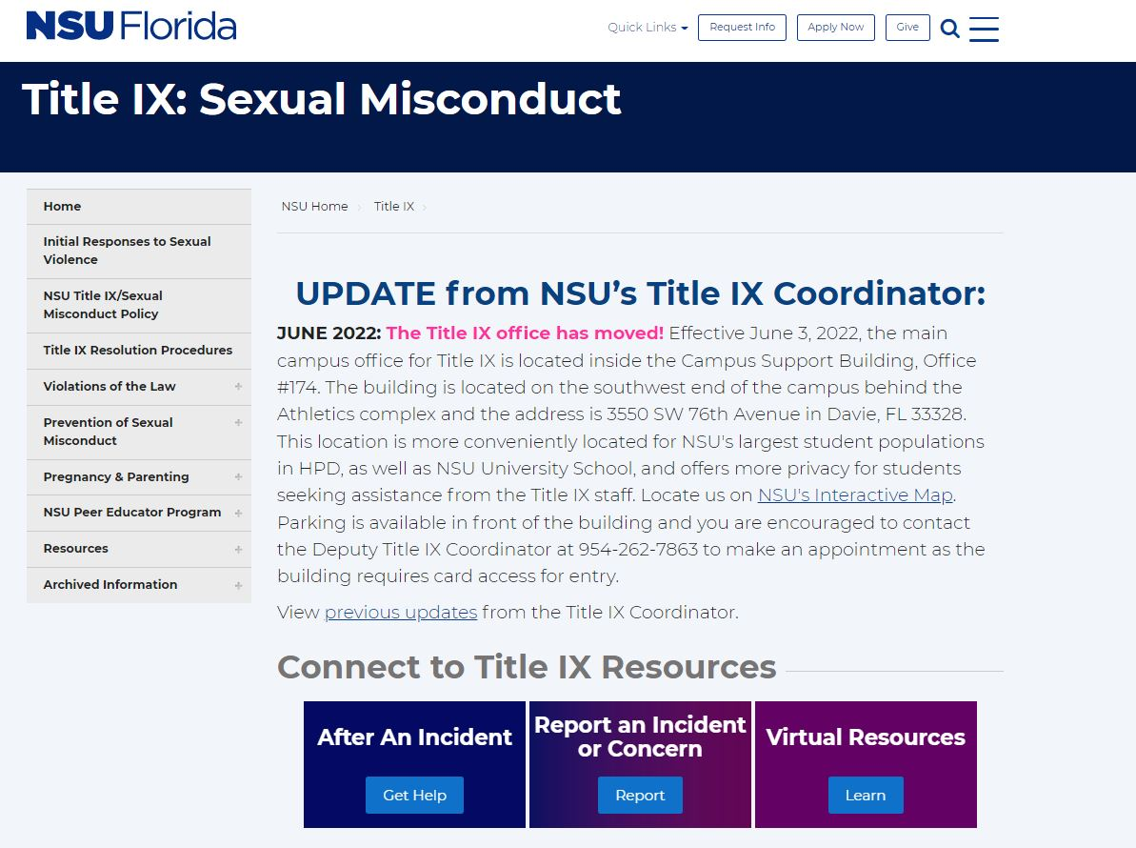
nova.edu/title-ix
Notes:
The NSU Title IX website provides easy access to the secure online reporting form. This allows the Title IX Coordinator to reach out directly to the affected person to offer information about resources, support, and options.

Slide 11
Contact us!
Dr. Bohdan “Bo” Zaryckyj, Title IX Investigator (954) 262-7863 bzarycky@nova.edu
Laura Bennett, Title IX Coordinator (954) 262-7858 laura.bennett@nova.edu
Website: www.nova.edu/title-ix Email: titleix@nova.edu
Office Locations on NSU Ft. Lauderdale/Davie Campus & East Campus

Slide 12
Questions & Discussion

